Slide 1
MSMClient Setup
Creator: Ruby Pham
July 2nd 2018

Slide 2
Agenda
Prerequisites Setup
DB Setup
MSMClient Setup
VS Code Debugging
Q & A

Slide 3
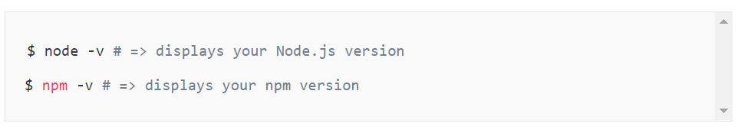
Prerequisites
Before you can use Angular CLI, you must have Node.js 6.9.0 and npm 3.0.0 or higher installed on your system.
You can download the latest version of Node.js for your operating system and consult the latest installation instructions on the official Node.js website.
If you already have Node.js and npm installed, you can verify their version by running:

Slide 4
Prerequisites (con’t)
Once you have Node.js installed, you can use the npm command to install TypeScript, or install it from the official website directly.
$ npm install -g typescript@2.9
Although TypeScript is technically not an absolute requirement, it’s highly recommended by the Angular team, so I recommend you install it to make working with Angular as comfortable as possible.
Now that you have Node.js and TypeScript installed, you can install Angular CLI.

Slide 5
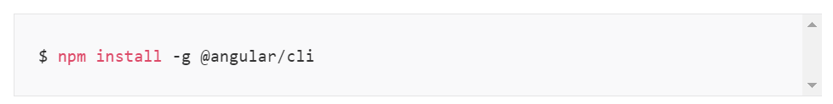
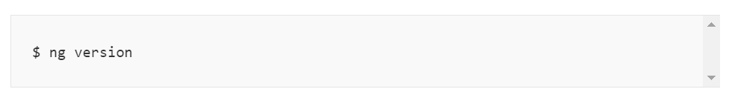
Installing Angular CLI
To install Angular CLI, run:
This will install the ng command globally on your system.
To verify whether your installation completed successfully, you can run this:
This displays the version you have installed:

Slide 6
Installing Visual Code
Although VS Code is technically not an absolute requirement, it’s highly recommended by the Front-end team, so I recommend you install it to make working with Front-end as comfortable as possible.
You can download the latest version of VS Code for your operating system and consult the latest installation instructions on the official VS Code website.

Slide 7
Source Code
You can download the project via link:
https://elno1git01/DefaultCollection/HTML5%20MSMClient

Slide 8
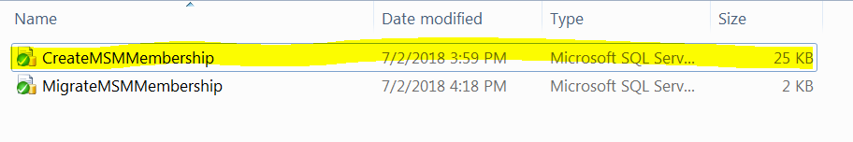
DB Setup
For the membership db, please follow these instructions to create a db:
1: Navigate to the directory: ..\ MSMAuthService\MSMAuthService\Scripts
2: Run “CreateMSMMembership” script to create a new db call “MSMMembership”

Slide 9
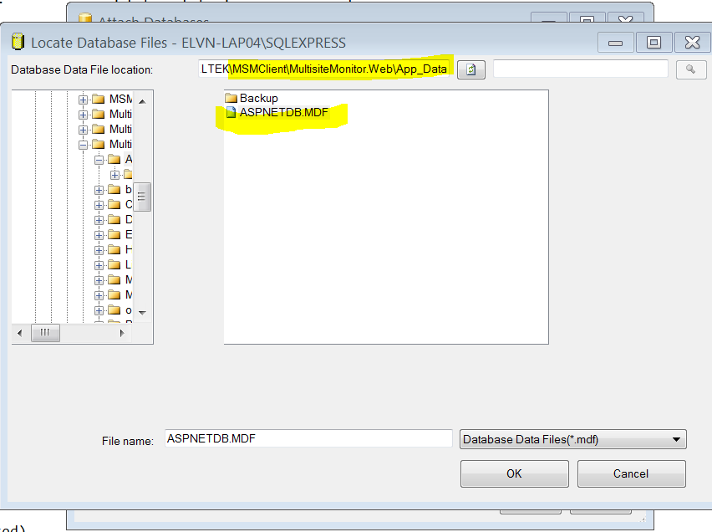
DB Setup (Cont’)
3: Attach (not Restore) the membership db in Silverlight app, and rename it to RIAMembership.
4: Run “MigrateMSMMembership” script to migrate data to new system.

Slide 10
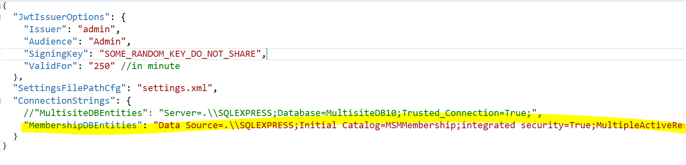
MSMClient Setup
Open the MSMAuthService and update the connection string:

Slide 11
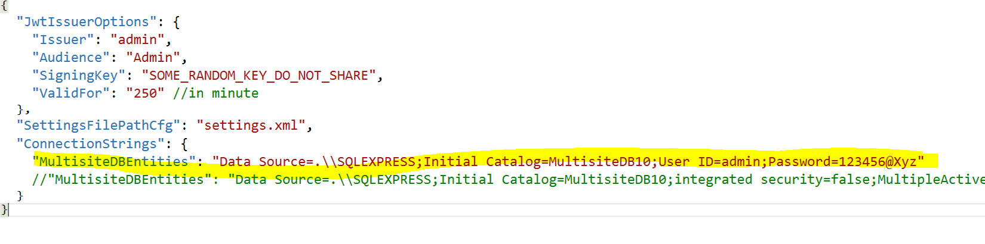
MSMClient Setup (Cont’)
Open the MSMClientAPIService and update the connection string. Because we are using SingalR mechanism, so we need to provide username/password to login to the db.

Slide 12
MSMClient Setup (Cont’)
Enable the broker to use signalR mechanism by running this command in the SQL Server
ALTER DATABASE MultisiteDB10 SET ENABLE_BROKER

Slide 13
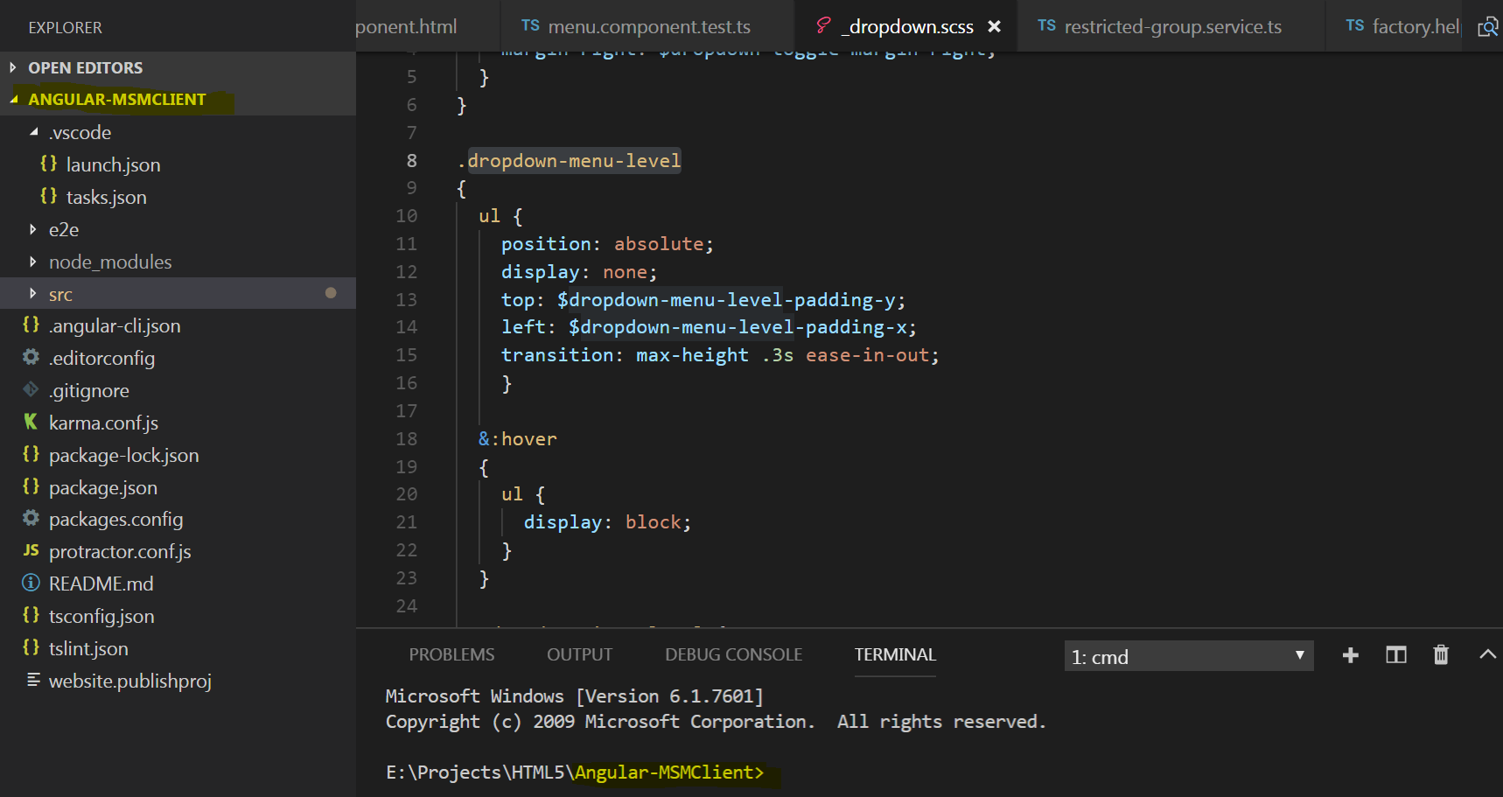
MSMClient Setup (Cont’)
1: Open Angular-MSMClient in the VS Code
2: Type “npm install” in the terminal window to install necessary files
3: After all necessary files installed successful, type “npm start” to run the application

Slide 14
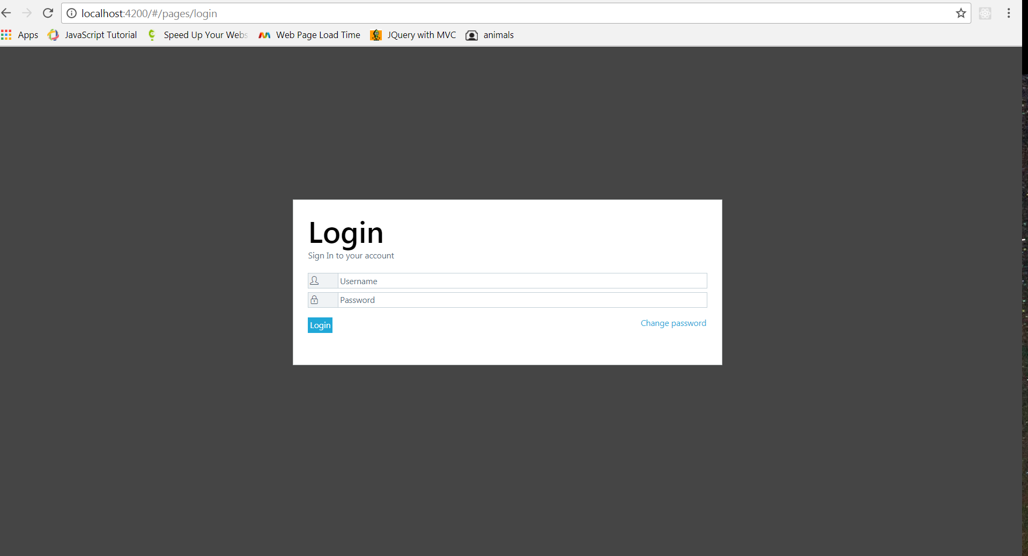
MSMClient Setup (Cont’)
Finally, open your browser on localhost:4200

Slide 15
VS Code Debugging
1: Install this one: https://marketplace.visualstudio.com/items?itemName=msjsdiag.debugger-for-chrome
2: Restart VS Code and open the folder containing the project you want to work on.
3: After a project is built successfully (nmp start), press F5 and start debugging exactly as the Visual Studio.

Slide 16
Q & A

